Slide 1

Mastering Data with Awesome Chocolates
Excited to share my latest guided project on EXCEL, where I explore the world of data with Awesome Chocolate's employee dataset. This project demonstrates
Understanding the Dataset
Identifying Data Quality Issues
Cleaning Data
Structuring Data
Analyzing Data and Identifying Business Problems &
Visualizing Data
Stay tuned for a detailed journey through data!
@Athira Beena
Notes:
• Welcome everyone to our session on "Mastering Data: A Step-by-Step Guide to Cleaning, Analyzing, and Visualizing Data with Excel for Beginners". • In this presentation, we'll be exploring the powerful capabilities of Microsoft Excel to transform raw data into meaningful insights. • The dataset we'll be working with today is the Awesome Chocolates employee data, which includes employees from both India and New Zealand. • We'll be going through a comprehensive process of cleaning, analyzing, and visualizing this data to uncover valuable information that can help drive business decisions. • By the end of this session, you'll have the knowledge and confidence to tackle your own data challenges using the versatile tools and techniques in Excel. • Let's dive in and get started!

Slide 2

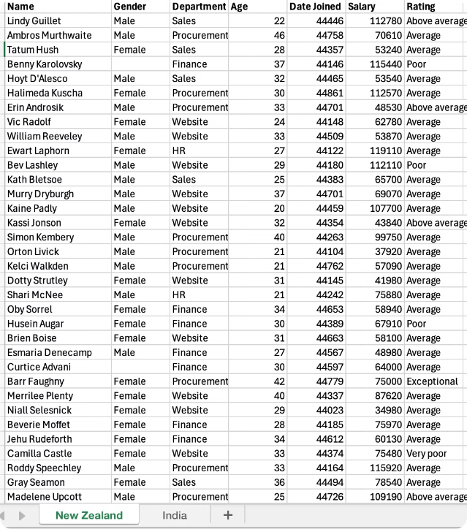
Understanding the Dataset
Key Data Points
Employee Demographics (India & New Zealand): Age, Gender, Department
Employee Performance: Salary, Rating, Date Joined
@Athira Beena

Slide 3
Identifying Data Quality Issues
The Gender column contains missing values.
Dates are represented in numeric format.
Currency is absent from the Salary column.
Sorting the Salary column will help identify any Outliers** or extreme values.
Outliers** are data points that fall very far outside the overall distribution of a dataset - can be the very smallest or largest values compared to the other values in the dataset.
@Athira Beena

Slide 4




Data Cleaning Techniques Used
Handled MissingData
Removed Duplicates
Number Formatting
Outlier Check
@Athira Beena

Slide 5

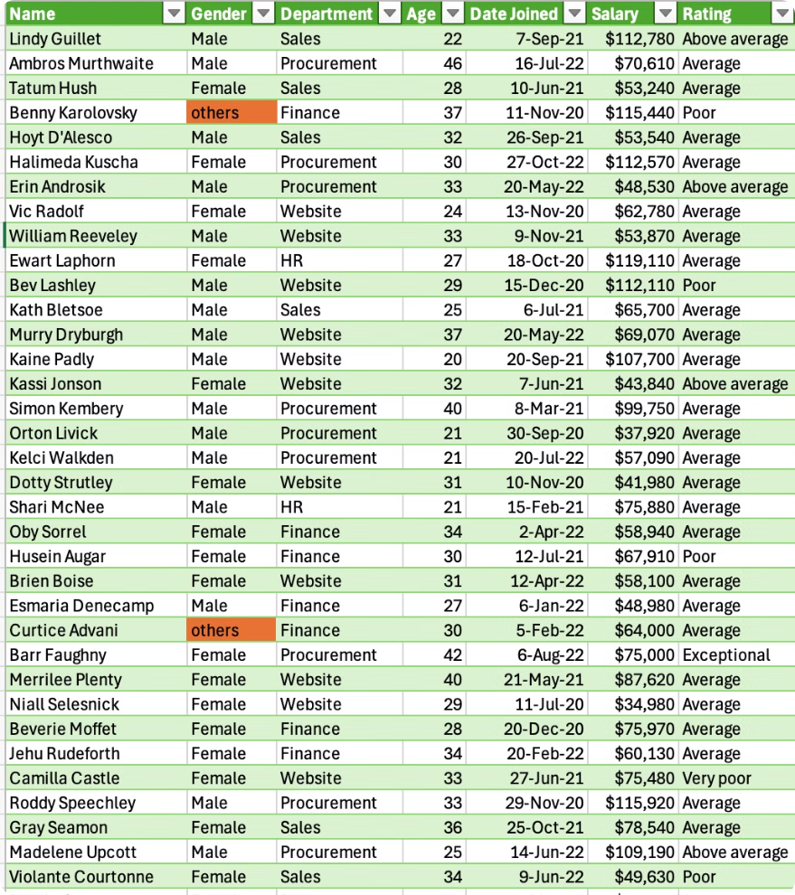
Data Cleaning - Summary
Filled missing "Gender" values with 'Others'.
Identified and removed duplicate entries using conditional formatting.
Ensured consistent formatting for currency, percentages, and dates.
Analyzed the data for outliers using a boxplot ( no significant outliers were identified) .
After cleaning, the data is converted to tabular format, ensuring it is well-organized and ready for analysis
@Athira Beena

Slide 6

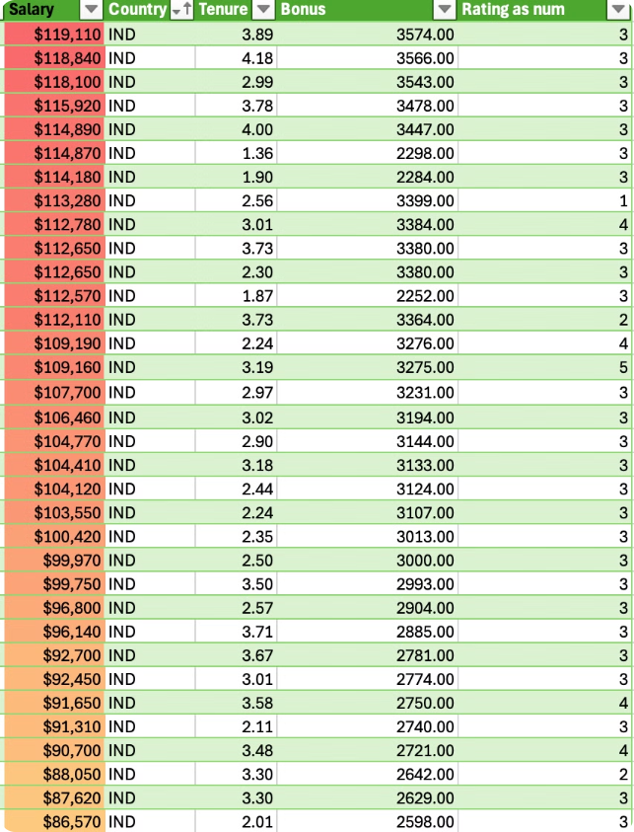
Structuring Data
Combining Sheets using Power Query: Merged data from India and New Zealand into a single organized table.
Adding Columns: Added a 'Country' column to differentiate 'IND' & 'NZ' employees.
Sorting & Filtering: Sorted salaries and applied colour scales to visualize distribution.
Data Formatting: Applied consistent formatting for improved readability.
Creating Calculated Columns: Added columns for Tenure, Bonus and Rating as num using Excel's powerful formulas and functions.
Pivot Tables: Used pivot tables to summarize and analyze data, enabling easy extraction of meaningful insights and trends.
@Athira Beena

Slide 7
Statistical Analysis
Statistics
Value
Formula
Explanation
Count of Employees
182
=COUNTA(Name)
Counts the total number of employees.
Average Salary
$76,963
=AVERAGE(Salary)
Calculates the mean salary of all employees.
Median Salary
$75000
=MEDIAN((Salary)
Calculates the median salary of all employees.
Average Age
30.39
=AVERAGE(Age)
Calculates the mean age of all employees.
Average Tenure (years)
2.87
=AVERAGE((TODAY() - DateJoined)/365)
Calculates the mean tenure in years by subtracting the date joined from today's date and dividing by 365.
Observation from Mean and Median Salary: The median salary is $75,000, which is lower than the MEAN(Avg) salary. This suggests that some higher salaries are pulling the mean to the right, indicating a slight right skew in the data.
@Athira Beena

Slide 8

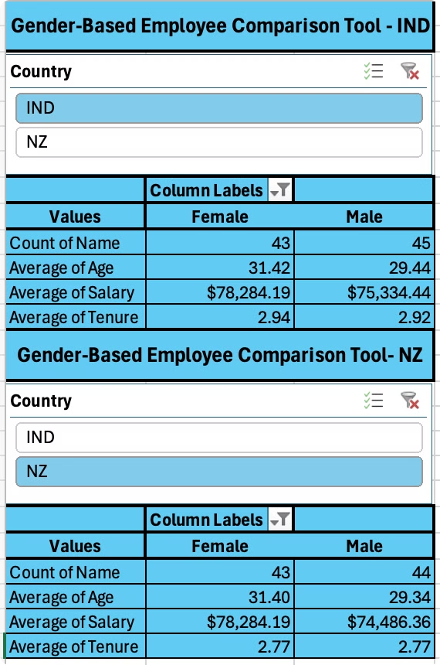
Gender Based Employee Comparison
Objective : Identify any disparities in age, salary, and tenure between male and female employees across IND & NZ.
Solution: Utilized Pivot Charts and Slicers for Analysis
Insights
»Salary: On average, female employees have slightly higher salaries compared to male employees across both India (IND) and New Zealand (NZ).
»Age: Female employees tend to be older on average compared to male employees in both countries.
»Tenure: There is a balanced distribution of tenure between male and female employees, showing similar lengths of service across IND & NZ.
@Athira Beena

Slide 9
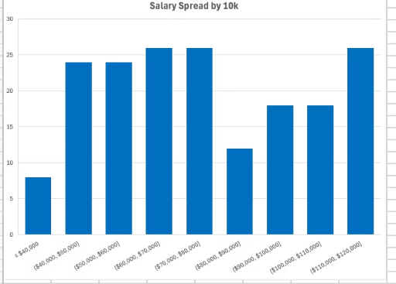
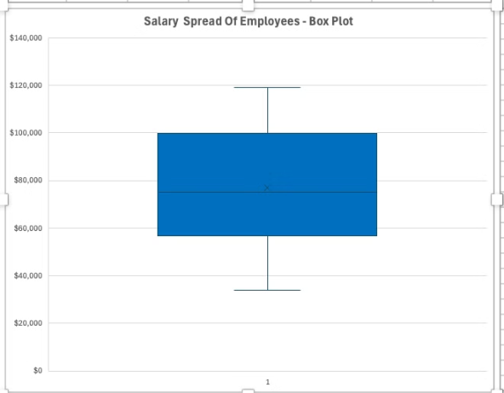
Employee Salary Distribution
Objective: Gain insights into how employee salaries are distributed across the organization.
» Identifying potential pay gaps .
» Informing future compensation decision.
Solution: Analyzed employee salary data using Histogram & Boxplot .
Insights
Histogram is better for visualizing the entire salary distribution
Insights
Salary Range: Employee salaries range from $40,000** to $120,000 (X-axis)
Box plot gives 5 number summary for Salary
Min salary - $33920
Salary Concentration: The height of the bars in the histogram (Y-Axis) indicates the number of employees within each salary range
Max salary - $120,000
Median salary - $75000
Distribution: The salary distribution appears to be slightly skewed towards right (longer tail on the right side). Mean ($76963) is typically higher than the median ($75000) because the higher salaries pull the mean to the right.
Q1 - $56,870 - Q1 is the 25th percentile, meaning 25% of the employees earn less than $56,870.
Q3 - $100,000. Q3 is the 75th percentile, meaning 75% of the employees earn less than $100,000.
IQR : Q3 - Q1 - The 50% of the employees have salaries between $56,870 and $100,000.
Analogy : Think of the salary spread like a seesaw. While most employees are clustered around the left side (the majority), there are a few on the right side who earn higher salaries, tipping the seesaw slightly to the right.
No Outliers** detected in the box plot
Outliers** are data points that fall very far outside the overall distribution of a dataset - can be the very smallest or largest values compared to the other values in the dataset.
Salary Concentration: A higher concentration of employees falls within the $40,000- $80,000 range. Also, between 110k and 120k.
Very few people have salary between - $80k -$ 90k.
Understanding the Interquartile Range (IQR) in Salary Data
» IQR - Interquartile Range is represented by the middle box in the box plot.
**Underflow Bin is 40,000
» IQR is the range between the first quartile (Q1) and the third quartile (Q3) of a dataset. It measures the spread of the middle 50% of the data.
@Athira Beena

Slide 10
Identifying Potential Pay Gaps
Observations: The histogram highlights areas where salary distribution is uneven, particularly around the $80,000-$90,000 range. This gap could indicate potential disparities in compensation.
Recommendation: Need to consider factors such as role seniority, departmental differences, or gender disparities that may contribute to inequities.
Future Compensation Decisions:
Data-Driven Insights: Adjusting salary ranges, implementing performance-based incentives, or revising compensation policies can be implemented to address identified gaps.
@Athira Beena

Slide 11

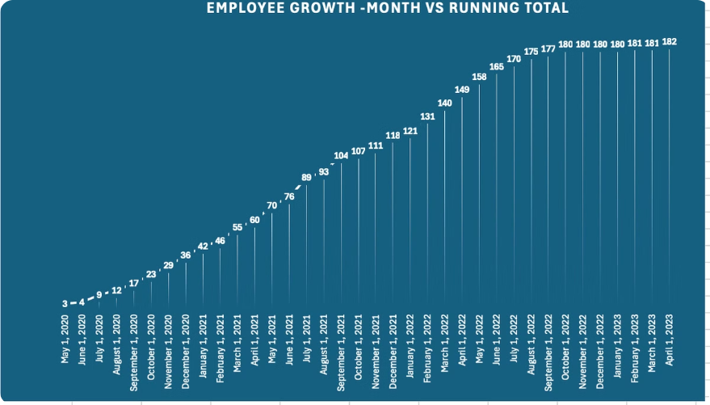
Line chart - Employee Count by Year
Steady growth: The line is increasing at a consistent pace, it suggests a steady growth in employee headcount from 2020 to 2023.
@Athira Beena

Slide 12
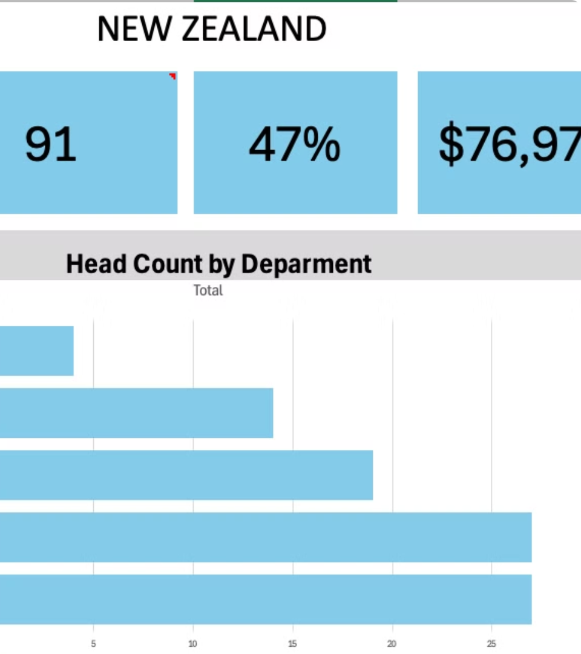
Score Card - NZ
Number of employees - 91
Female employee percentage - 47%
Average salary - $76,979
The bar chart shows that Procurement has the highest number of employees, followed by Website.
HR department has lowest .
@Athira Beena

Slide 13
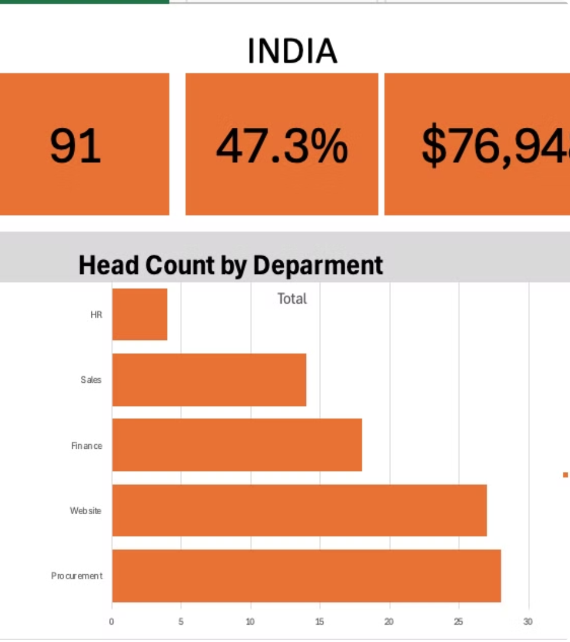
Score Card - INDIA
Number of employees - 91
Female employee percentage - 47.3%
Average salary - $76,948
The bar chart shows that Procurement has the highest number of employees, followed by Website.
HR department has lowest .
@Athira Beena

Slide 14
Thank you for your attention!
Any questions or suggestions for improvement, please leave a comment.
Found this useful, feel free to share it.
@Athira Beena

